Slide 1
Door Locker And Detector
A PROJECT PROPOSAL
Presented to
the Faculty of College of Computer Science and Information Science
Malayan Colleges Mindanao
Davao City
By
Abid, James
Cherry B. Lisondra
Instructor

Slide 2
INTRODUCTION
BRIEF DESCRIPTION
Brief Description: By using the Ultrasonic Distance Sensor to detect the person on the opposite side of the door, Servo motor to control the lock, and buzzer for detection to provide minimal yet enhanced security and privacy on your home or your office.

Slide 3
ELECTRONIC COMPONENTS
Electronic components:
Ultrasonic Distance Sensor
Servo motor
Arduino Uno
Peizzo Buzzer

Slide 4
POTENTIAL USERS
This study benefits the following:
Home
-To provide small yet efficient privacy and security in your home or room, especially for people who work at home.
Office
-To provide small yet efficient privacy and security in your office, especially when you are on a meeting and avoid unnecessary disturbances.

Slide 5
PURPOSE OF THE STUDY
The purpose of this study is to provide a minimal, efficient, and budget friendly security system to on your home or your office. It would minimize any unwanted disturbances from the opposite side of your door.

Slide 6
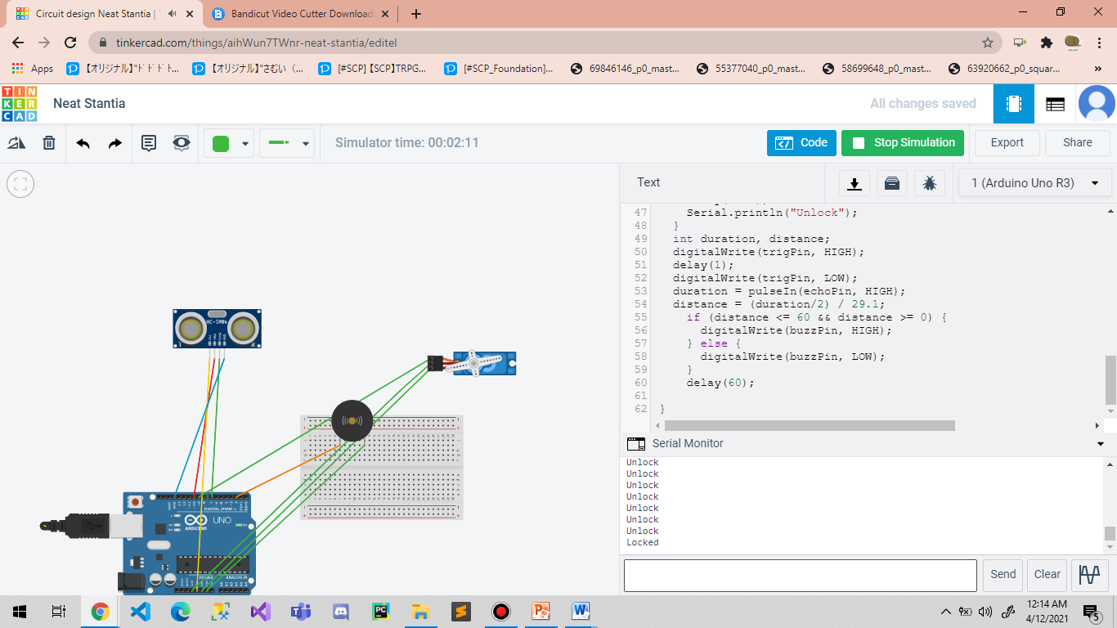
Simulation
This image is represents if there is presence detected, the buzzer will alarm. The servo motor is still lock.

Slide 7

Simulation
This second image if the user pressed one, the servo will unlock the door`s lock. If there is no presence detected, the buzzer will silent.

